Slide 1

WELCOME
COHORT 5
7th Sept – 3rd Dec 2026
Suite 6-6-7, Level 6, Menara MAA

Slide 2
Understanding Side Effects in React
What are Side Effects?
Operations that affect something outside the component's scope
Actions that don't directly relate to rendering UI

Slide 3
Understanding Side Effects in React
Common Side Effects:
Data fetching from APIs
Setting up subscriptions or event listeners
Manually changing the DOM
Timers and intervals
Cleanup operations

Slide 4
Understanding Side Effects in React
Why useEffect?
Functional components need a way to perform side effects
Replaces lifecycle methods from class components
Provides a unified API for different lifecycle phases

Slide 5
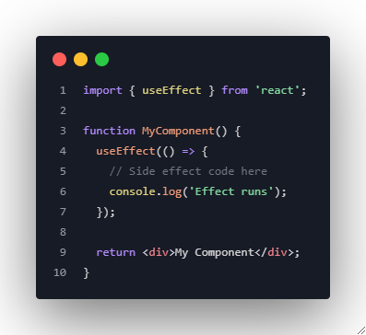
useEffect Hook Fundamentals
Basic Syntax:

Slide 6
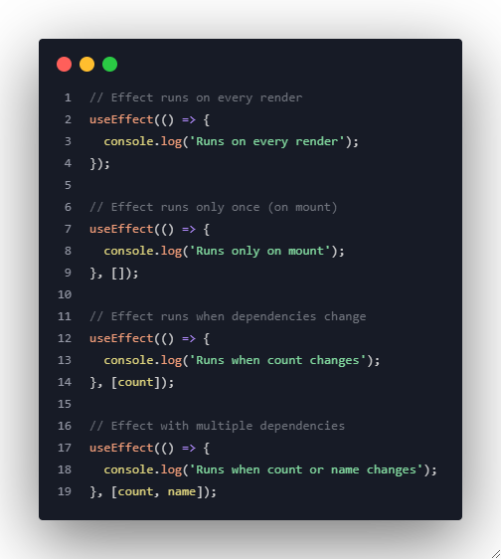
useEffect Hook Fundamentals
useEffect with Dependency Array:

Slide 7
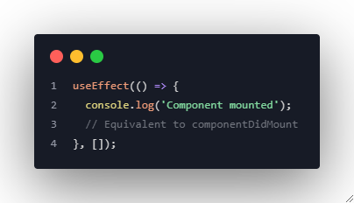
Component Lifecycle with useEffect
Mounting (Component Creation):

Slide 8
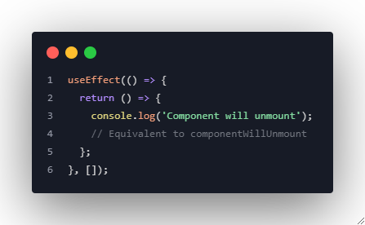
Component Lifecycle with useEffect
Unmounting (Component Removal):

Slide 9
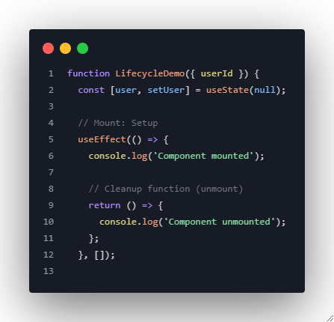
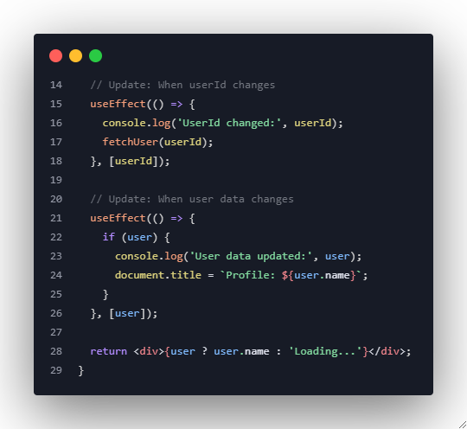
Component Lifecycle with useEffect
Complete Lifecycle Example:
Notes:
import { useEffect, useState } from "react";
function LifecycleDemo({ userId }) {
// Initially, 'user' is set to null (no user data yet)
const [user, setUser] = useState(null);
// Mock fetch function
// async means it works asynchronously (it waits for data to load)
const fetchUser = async (id) => {
try {
// fetch user data from a free fake API
const response = await fetch(`https://jsonplaceholder.typicode.com/users/${id}`);
const data = await response.json();
// save the user data into the 'user' state variable
setUser(data);
} catch (error) {
// if got error (e.g., no internet), print in console
console.error("Failed to fetch user:", error);
}
};
// Mount: Setup
// when the component first appears on the screen
useEffect(() => {
console.log('Component mounted'); // Runs once when the component loads
// Cleanup function (unmount)
// runs when the component is removed from the screen
return () => {
console.log('Component unmounted');
};
}, []);
// empty array [] means this effect runs only once (when mounted/unmounted)
// Update: When userId changes
useEffect(() => {
console.log('UserId changed:', userId);
// Whenever userId changes, call fetchUser to load the new user data
fetchUser(userId);
}, [userId]);
// This effect will run every time the value of 'userId' changes
// Update: When user data changes
useEffect(() => {
// only run this part if user data is available
if (user) {
console.log('User data updated:', user);
// change the tab title in the browser to show the user's name
document.title = `Profile: ${user.name}`;
}
}, [user]);
// This effect runs every time the 'user' state changes (after fetching new data)
// If user data exists, then show the user's name
// else, show "Loading..."
return <div>{user ? user.name : 'Loading...'}</div>;
}
export default LifecycleDemo;

Slide 10
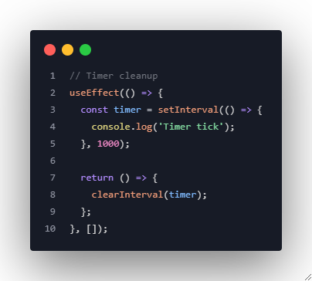
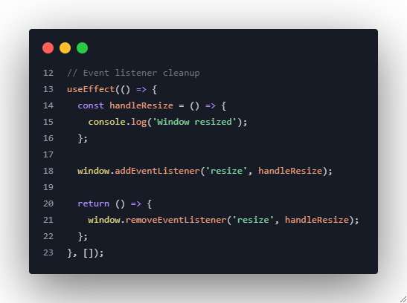
Cleanup Functions and Memory Leaks
Common Cleanup Scenarios:

Slide 11
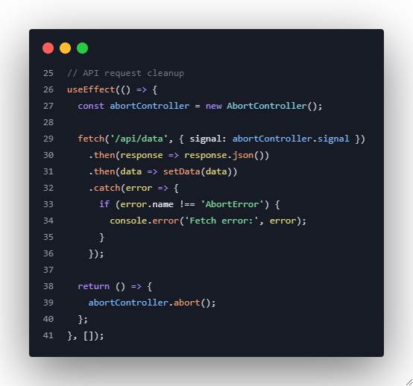
Cleanup Functions and Memory Leaks
Common Cleanup Scenarios:

Slide 12
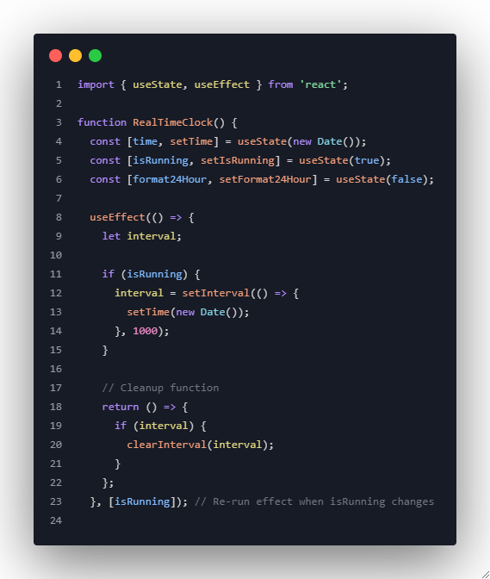
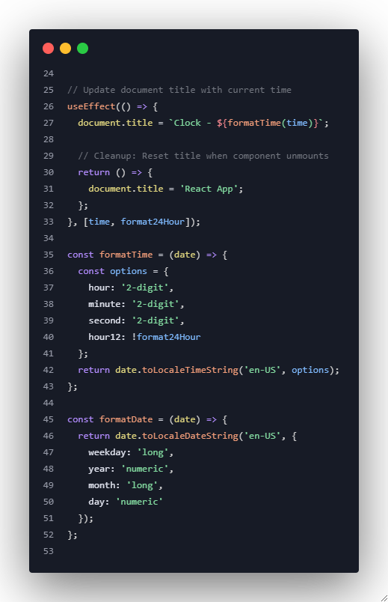
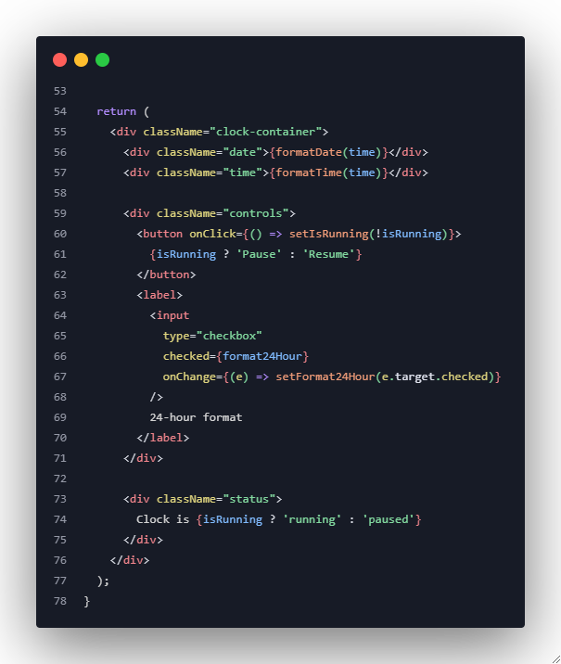
Example 1: Real-time Clock with Cleanup
Notes:
// useState for managing component data (state)
// useEffect for running side effect (like timers or document updates)
import { useState, useEffect } from 'react';
function RealTimeClock() {
const [time, setTime] = useState(new Date());
const [isRunning, setIsRunning] = useState(true);
const [format24Hour, setFormat24Hour] = useState(false);
useEffect(() => {
// declare a variable for storing the timer ID
let interval;
if (isRunning) {
// setInterval runs the function repeatedly every 1000 milliseconds (1 second)
interval = setInterval(() => {
// update the 'time' state with the current date/time
setTime(new Date());
}, 1000);
}
// Cleanup function
// The component is removed from the screen, or
// Before the effect re-runs (when isRunning changes)
return () => {
// Stop the timer if it exists to prevent multiple timers running together
if (interval) {
clearInterval(interval);
}
};
}, [isRunning]); // Re-run effect when isRunning changes
// Update document title with current time
useEffect(() => {
document.title = `Clock - ${formatTime(time)}`;
// Cleanup: Reset title when component unmounts
return () => {
document.title = 'React App';
};
}, [time, format24Hour]);
const formatTime = (date) => {
const options = {
hour: '2-digit',
minute: '2-digit',
second: '2-digit',
hour12: !format24Hour
};
return date.toLocaleTimeString('en-US', options);
};
const formatDate = (date) => {
return date.toLocaleDateString('en-US', {
weekday: 'long',
year: 'numeric',
month: 'long',
day: 'numeric'
});
};
return (
<div className="clock-container">
<div className="date">{formatDate(time)}</div>
<div className="time">{formatTime(time)}</div>
<div className="controls">
{/* Button to toggle pause/resume the clock */}
<button onClick={() => setIsRunning(!isRunning)}>
{isRunning ? 'Pause' : 'Resume'}
</button>
{/* Checkbox to toggle 24-hour format on/off */}
<label>
<input
type="checkbox"
checked={format24Hour}
onChange={(e) => setFormat24Hour(e.target.checked)}
/>
24-hour format
</label>
</div>
<div className="status">
Clock is {isRunning ? 'running' : 'paused'}
</div>
</div>
);
}
export default RealTimeClock;

Slide 13
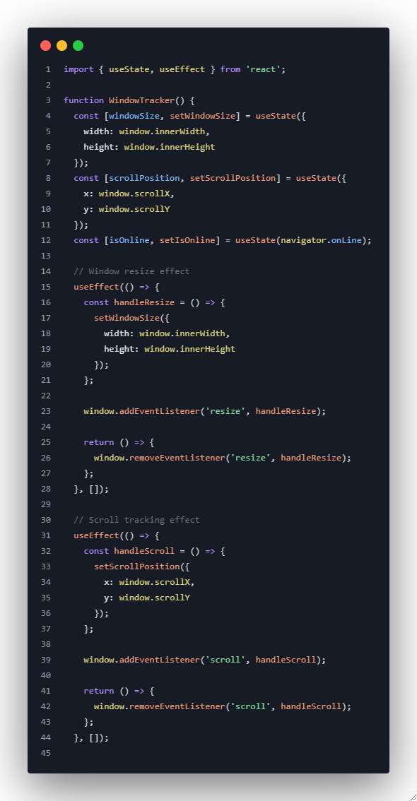
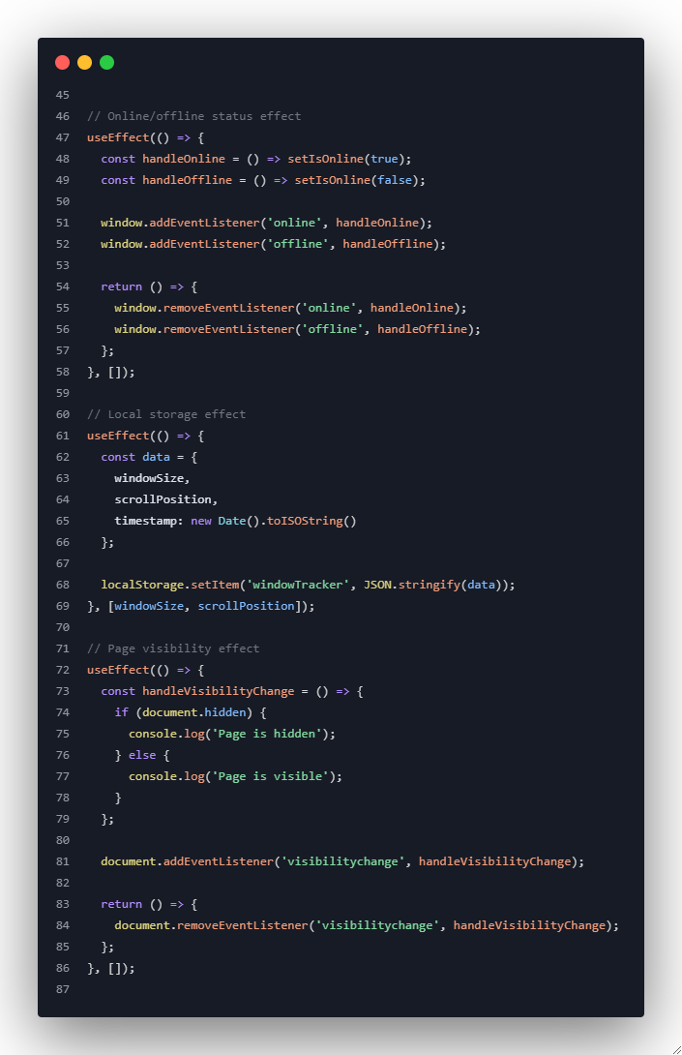
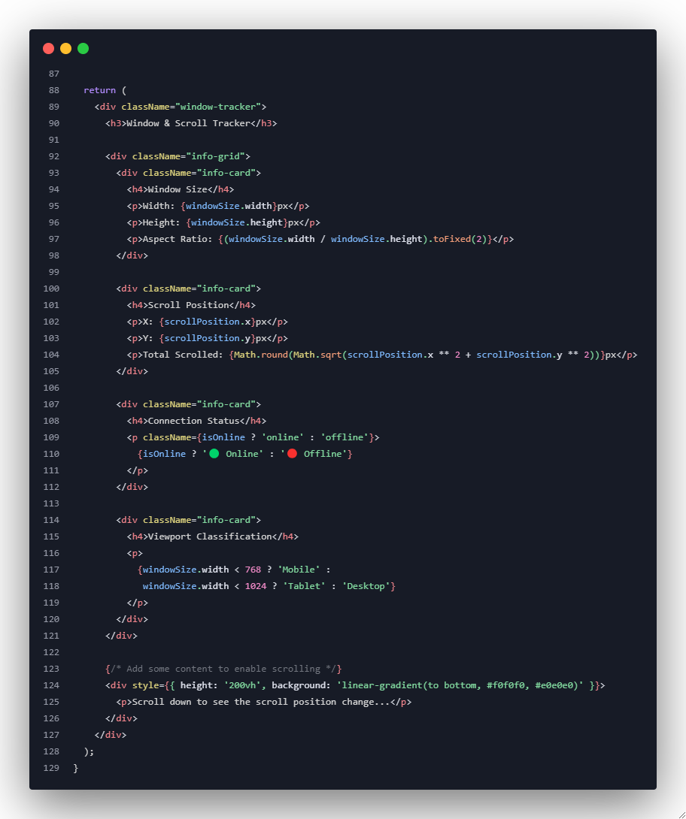
Example 2: Window Resize and Scroll Tracker
Notes:
// Import React Hooks
// useState → to store and update data (state)
// useEffect → to perform side effects (like event listeners or saving data)
import { useState, useEffect } from "react";
// Define the WindowTracker component
function WindowTracker() {
// --- STATE 1: WINDOW SIZE ---
// Store the current width and height of the browser window
const [windowSize, setWindowSize] = useState({
width: window.innerWidth, // current window width in pixels
height: window.innerHeight // current window height in pixels
});
// --- STATE 2: SCROLL POSITION ---
// Store the current scroll position of the page (horizontal and vertical)
const [scrollPosition, setScrollPosition] = useState({
x: window.scrollX, // distance scrolled horizontally
y: window.scrollY // distance scrolled vertically
});
// --- STATE 3: CONNECTION STATUS ---
// Store whether the user is online or offline
const [isOnline, setIsOnline] = useState(navigator.onLine);
// --- EFFECT 1: TRACK WINDOW RESIZE ---
useEffect(() => {
// Define a function to run every time the window is resized
const handleResize = () => {
setWindowSize({
width: window.innerWidth,
height: window.innerHeight
});
};
// Add an event listener that runs handleResize() whenever the window is resized
window.addEventListener('resize', handleResize);
// Cleanup function: remove the event listener when component unmounts
return () => {
window.removeEventListener('resize', handleResize);
};
}, []); // Empty dependency → runs only once when component mounts
// --- EFFECT 2: TRACK SCROLL POSITION ---
useEffect(() => {
// Define a function that runs whenever the page is scrolled
const handleScroll = () => {
setScrollPosition({
x: window.scrollX, // horizontal scroll position
y: window.scrollY // vertical scroll position
});
};
// Add event listener for scrolling
window.addEventListener('scroll', handleScroll);
// Cleanup function: remove scroll listener when component unmounts
return () => {
window.removeEventListener('scroll', handleScroll);
};
}, []); // Runs once on mount
// --- EFFECT 3: ONLINE / OFFLINE STATUS TRACKER ---
useEffect(() => {
// Define what happens when user goes online
const handleOnline = () => setIsOnline(true);
// Define what happens when user goes offline
const handleOffline = () => setIsOnline(false);
// Add both event listeners
window.addEventListener('online', handleOnline);
window.addEventListener('offline', handleOffline);
// Cleanup function: remove both listeners on unmount
return () => {
window.removeEventListener('online', handleOnline);
window.removeEventListener('offline', handleOffline);
};
}, []); // Runs once when component mounts
// --- EFFECT 4: SAVE DATA TO LOCAL STORAGE ---
useEffect(() => {
// Create a data object containing size, scroll, and timestamp
const data = {
windowSize,
scrollPosition,
timestamp: new Date().toISOString() // convert current time to readable string
};
// Save data as a string in the browser's local storage
// This allows it to persist even after refreshing
localStorage.setItem('windowTracker', JSON.stringify(data));
}, [windowSize, scrollPosition]);
// Runs every time the window is resized OR scrolled
// --- EFFECT 5: PAGE VISIBILITY TRACKER ---
useEffect(() => {
// Define what happens when the page becomes hidden or visible
const handleVisibilityChange = () => {
if (document.hidden) {
console.log('Page is hidden'); // Tab not visible
} else {
console.log('Page is visible'); // Tab visible again
}
};
// Add event listener for page visibility change
document.addEventListener('visibilitychange', handleVisibilityChange);
// Cleanup function: remove listener when component unmounts
return () => {
document.removeEventListener('visibilitychange', handleVisibilityChange);
};
}, []); // Runs only once on mount
// --- COMPONENT OUTPUT (WHAT WE SEE ON SCREEN) ---
return (
<div className="window-tracker">
<h3>Window & Scroll Tracker</h3>
{/* Display all tracked information in a grid layout */}
<div className="info-grid">
{/* WINDOW SIZE CARD */}
<div className="info-card">
<h4>Window Size</h4>
<p>Width: {windowSize.width}px</p>
<p>Height: {windowSize.height}px</p>
<p>
Aspect Ratio: {(windowSize.width / windowSize.height).toFixed(2)}
</p>
</div>
{/* SCROLL POSITION CARD */}
<div className="info-card">
<h4>Scroll Position</h4>
<p>X: {scrollPosition.x}px</p>
<p>Y: {scrollPosition.y}px</p>
<p>
Total Scrolled: {Math.round(Math.sqrt(
scrollPosition.x ** 2 + scrollPosition.y ** 2
))}px
</p>
{/* The line above calculates the diagonal scroll distance using Pythagoras */}
</div>
{/* ONLINE / OFFLINE CARD */}
<div className="info-card">
<h4>Connection Status</h4>
<p className={isOnline ? 'online' : 'offline'}>
{isOnline ? '🟢 Online' : '🔴 Offline'}
</p>
</div>
{/* DEVICE CLASSIFICATION CARD */}
<div className="info-card">
<h4>Viewport Classification</h4>
<p>
{/* Display device type based on width */}
{windowSize.width < 768 ? 'Mobile' :
windowSize.width < 1024 ? 'Tablet' : 'Desktop'}
</p>
</div>
</div>
{/* --- EXTRA SCROLL AREA --- */}
{/* Creates a tall area so students can test scroll tracking */}
<div style={{
height: '200vh', // 200% viewport height to enable scrolling
background: 'linear-gradient(to bottom, #f0f0f0, #e0e0e0)'
}}>
<p>Scroll down to see the scroll position change...</p>
</div>
</div>
);
}
// Export the component for use in other files
export default WindowTracker;

Slide 14
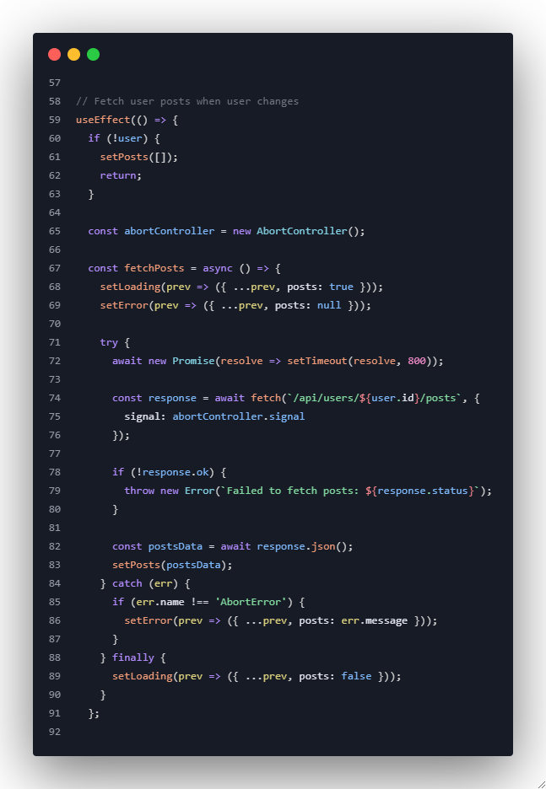
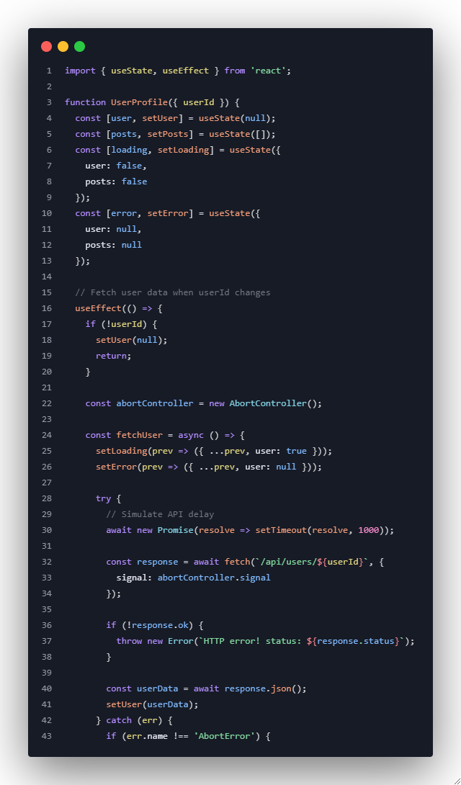
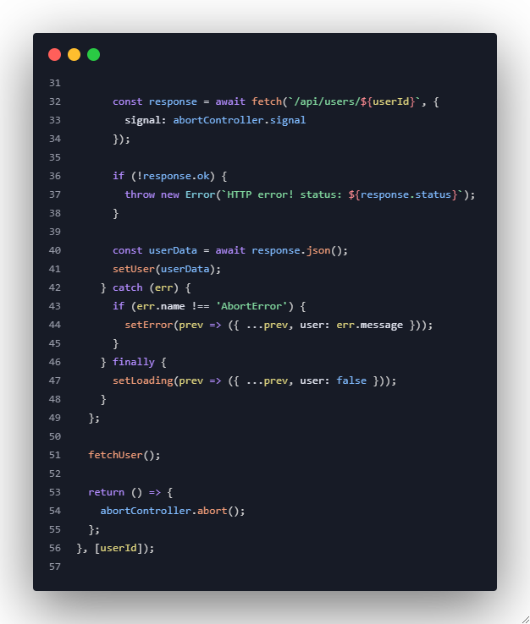
Example 3: Data Fetching with Loading States
Notes:
After line 91:
// Trigger fetching posts.
fetchPosts();
// Cleanup: abort posts fetch on dependency change / unmount.
return () => {
abortController.abort();
};
}, [user]);

Slide 15
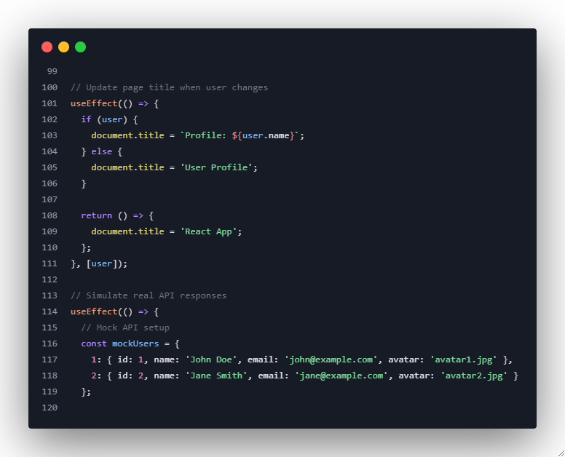
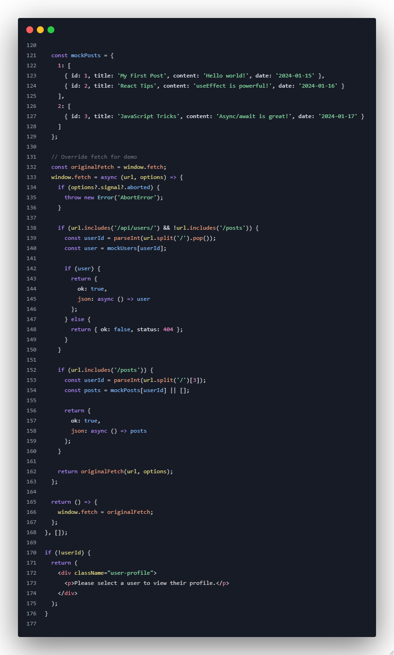
Example 3: Data Fetching with Loading States
Notes:
Full code with comments:
import { useState, useEffect } from "react";
// The UserProfile component fetches and displays a user's info and their posts.
// It demonstrates common React patterns: state, side effects, loading & error handling and cleanup.
function UserProfile({ userId }) {
// useState creates state variables and their setters.
// `user` will hold the fetched user object (or null when none).
const [user, setUser] = useState(null);
// `posts` will be an array of post objects related to the user.
const [posts, setPosts] = useState([]);
// `loading` keeps track of loading states for user and posts separately.
// We keep them together in an object so we can update parts without losing the other part.
const [loading, setLoading] = useState({
user: false, // true while user is being fetched
posts: false // true while posts are being fetched
});
// `error` keeps track of any error messages for user and posts.
const [error, setError] = useState({
user: null, // error message string if user fetch fails
posts: null // error message string if posts fetch fails
});
// ------------------------------------------------------------------
// Effect: Fetch user data when `userId` changes
// ------------------------------------------------------------------
useEffect(() => {
// If there's no userId, clear the user state and exit early.
if (!userId) {
setUser(null);
return; // nothing to fetch
}
// Create an AbortController so we can cancel the fetch if the component unmounts
// or userId changes before the fetch completes.
const abortController = new AbortController();
// Define an async function to fetch user data.
const fetchUser = async () => {
// Set loading state for user to true (preserve other loading flags using previous state).
setLoading(prev => ({ ...prev, user: true }));
// Clear previous user error before attempting a new fetch.
setError(prev => ({ ...prev, user: null }));
try {
// Simulate network/API delay so students can see the loading indicator.
await new Promise(resolve => setTimeout(resolve, 1000));
// Perform the actual fetch.
// We pass the abortController.signal to allow cancellation.
const response = await fetch(`/api/users/${userId}`, {
signal: abortController.signal
});
// If the HTTP status is not in the 200-299 range, treat it as an error.
if (!response.ok) {
throw new Error(`HTTP error! status: ${response.status}`);
}
// Parse the JSON response body into an object.
const userData = await response.json();
// Save the user into state so React will re-render and show the data.
setUser(userData);
} catch (err) {
// If the fetch was aborted, fetch throws an AbortError (or we used the signal).
// We don't want to set an error for aborts because they are expected during cleanup.
if (err.name !== 'AbortError') {
// Save the error message into state for displaying to the user.
setError(prev => ({ ...prev, user: err.message }));
}
} finally {
// No matter success or error, set loading.user back to false.
setLoading(prev => ({ ...prev, user: false }));
}
};
// Start the fetch.
fetchUser();
// Cleanup function for this effect: abort the in-flight fetch if userId changes or
// the component unmounts. This prevents setting state on an unmounted component.
return () => {
abortController.abort();
};
}, [userId]); // re-run this effect when userId changes
// ------------------------------------------------------------------
// Effect: Fetch posts when `user` changes (i.e., after user is loaded)
// ------------------------------------------------------------------
useEffect(() => {
// If there's no user loaded yet, clear posts and do nothing.
if (!user) {
setPosts([]);
return;
}
// Create an AbortController for the posts fetch as well.
const abortController = new AbortController();
const fetchPosts = async () => {
// Set posts loading flag and clear previous posts error.
setLoading(prev => ({ ...prev, posts: true }));
setError(prev => ({ ...prev, posts: null }));
try {
// Small delay to simulate network latency for demonstration.
await new Promise(resolve => setTimeout(resolve, 800));
// Fetch the posts for the loaded user using their id.
const response = await fetch(`/api/users/${user.id}/posts`, {
signal: abortController.signal
});
// Check response status and error if not ok.
if (!response.ok) {
throw new Error(`Failed to fetch posts: ${response.status}`);
}
// Parse posts JSON and save to state.
const postsData = await response.json();
setPosts(postsData);
} catch (err) {
// Ignore aborts but save other errors into state.
if (err.name !== 'AbortError') {
setError(prev => ({ ...prev, posts: err.message }));
}
} finally {
// Turn off the posts loading flag.
setLoading(prev => ({ ...prev, posts: false }));
}
};
// Trigger fetching posts.
fetchPosts();
// Cleanup: abort posts fetch on dependency change / unmount.
return () => {
abortController.abort();
};
}, [user]); // re-run this effect when `user` object changes
// ------------------------------------------------------------------
// Effect: Update page title when the user changes
// ------------------------------------------------------------------
useEffect(() => {
// If we have a user, include their name in the document title.
if (user) {
document.title = `Profile: ${user.name}`;
} else {
// Otherwise use a generic title.
document.title = 'User Profile';
}
// Cleanup: when effect is torn down (component unmounts or before next run),
// reset the title to a default value. This keeps global side-effects tidy.
return () => {
document.title = 'React App';
};
}, [user]); // re-run when `user` changes
// ------------------------------------------------------------------
// Effect: Mock/fake the fetch API for demo purposes so this component works
// without a real backend. This is only for teaching/demo; in real apps
// you would not overwrite window.fetch.
// ------------------------------------------------------------------
useEffect(() => {
// Example mock data for users and posts.
const mockUsers = {
1: { id: 1, name: 'John Doe', email: 'john@example.com', avatar: 'avatar1.jpg' },
2: { id: 2, name: 'Jane Smith', email: 'jane@example.com', avatar: 'avatar2.jpg' }
};
const mockPosts = {
1: [
{ id: 1, title: 'My First Post', content: 'Hello worlds!', date: '2024-01-15' },
{ id: 2, title: 'React Tips', content: 'useEffect is powerful', date: '2024-01-16' }
],
2: [
{ id: 3, title: 'Javascript Tricks', content: 'Async/await is great!', date: '2024-01-17' }
]
};
// Keep the original fetch so we can restore it when this effect cleans up.
const originalFetch = window.fetch;
// Override window.fetch with a simple mock for the demo.
window.fetch = async (url, options) => {
// If the provided AbortSignal says the request was aborted, throw an AbortError-like object.
if (options?.signal?.aborted) {
// Note: real fetch would throw a DOMException named 'AbortError'.
const err = new Error('AbortError');
err.name = 'AbortError';
throw err;
}
// If the URL matches our users endpoint (but not posts), return a user.
if (url.includes('/api/users/') && !url.includes('/posts')) {
const userId = parseInt(url.split('/').pop());
const user = mockUsers[userId];
if (user) {
return {
ok: true,
json: async () => user
};
} else {
// Simulate a 404 Not Found response shape.
return { ok: false, status: 404 };
}
}
// If the URL matches posts endpoint, return the user's posts.
if (url.includes('/post')) {
// url structure expected: /api/users/:id/posts
const userId = parseInt(url.split('/')[3]);
const posts = mockPosts[userId] || [];
return {
ok: true,
json: async () => posts
};
}
// For any other URL, fall back to the original fetch.
return originalFetch(url, options);
};
// Cleanup: restore the original fetch when component unmounts.
return () => {
window.fetch = originalFetch;
};
}, []); // empty dependency -> run once on mount
// ------------------------------------------------------------------
// Render logic: show different UIs depending on userId, loading, errors, and data.
// ------------------------------------------------------------------
// If parent didn't pass a userId, prompt the user to select one.
if (!userId) {
return (
<div className="user-profile">
<p>Please select a user to view their profile.</p>
</div>
);
}
// Main rendered UI when a userId was provided.
return (
<div className="user-profile">
<div className="user-section">
<h2>User Profile</h2>
{/* Show loading state for the user fetch */}
{loading.user && <div className="loading">Loading user...</div>}
{/* Show an error message and a simple retry button if fetching user failed */}
{error.user && (
<div className="error">
Error loading user: {error.user}
{/* Using window.location.reload for demo; in real apps provide a proper retry function. */}
<button onClick={() => window.location.reload()}>Retry</button>
</div>
)}
{/* When user is available and not loading, display the user's info */}
{user && !loading.user && (
<div className="user-info">
<img src={user.avatar} alt={user.name} />
<h3>{user.name}</h3>
<p>{user.email}</p>
</div>
)}
</div>
<div className="posts-section">
<h3>User Posts</h3>
{/* Loading indicator for posts */}
{loading.posts && <div className="loading">Loading posts...</div>}
{/* Error message for posts */}
{error.posts && (
<div className="error">
Error loading posts: {error.posts}
</div>
)}
{/* Render list of posts when available */}
{posts.length > 0 && !loading.posts && (
<div className="posts-lists">
{posts.map(post => (
<div key={post.id} className="post-card">
<h4>{post.title}</h4>
<p>{post.content}</p>
<small>{post.date}</small>
</div>
))}
</div>
)}
{/* If there are no posts (and no error/loading), show a friendly message */}
{posts.length === 0 && !loading.posts && !error.posts && user && (
<p>No posts found for this user.</p>
)}
</div>
</div>
);
}
export default UserProfile;

Slide 16
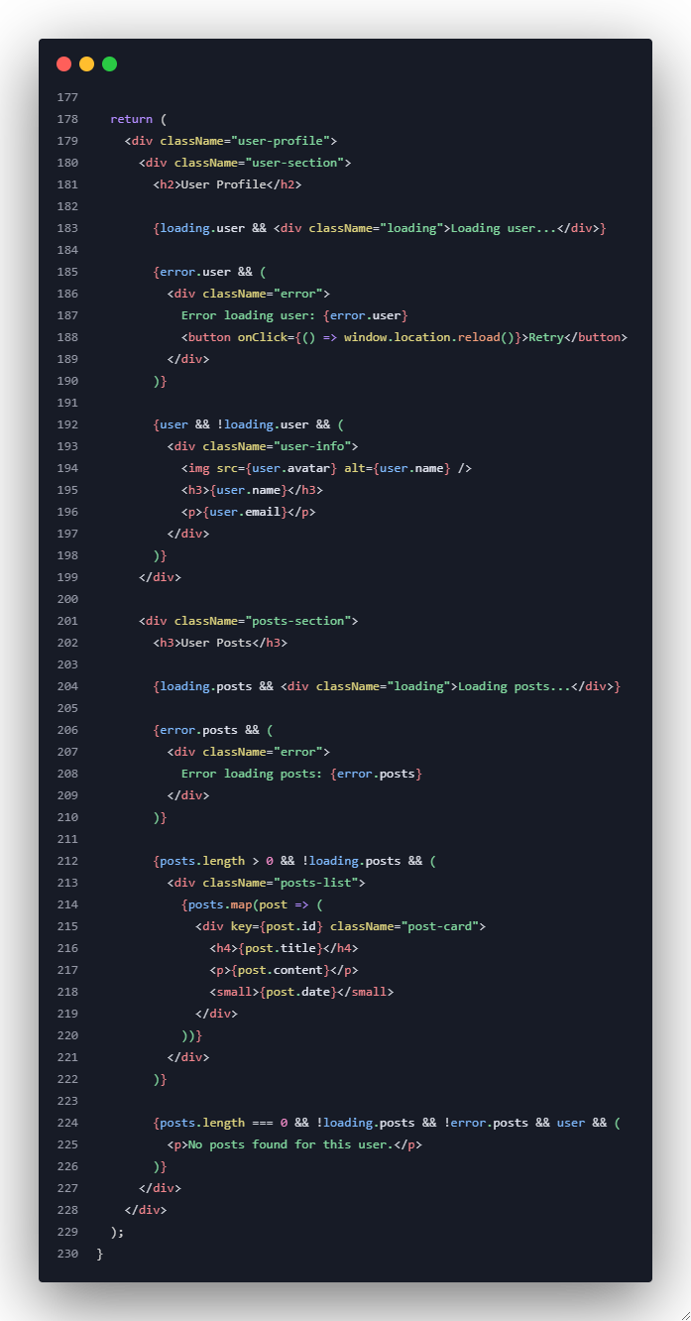
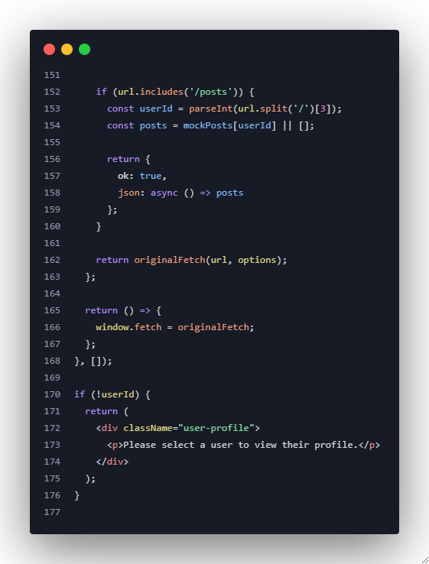
Example 3: Data Fetching with Loading States
Notes:
function App() {
return(
<div>
<h2>Example 3: Data Fetching with Loading States</h2>
<h3>Select a User</h3>
<div style={{ display: "flex", gap: "10px" }}>
{Object.values(mockUsers).map((user) => (
<button key={user.id} onClick={() => setSelectedUserId(user.id)}>
{user.name}
</button>
))}
</div>
<hr />
<UserProfile userId={selectedUserId} />
</div>
);
}
export default App;

Slide 17
Exercise 1: Live Chat Simulator
Task: Build a chat component that simulates real-time messages
Requirements:
Auto-generate messages every few seconds
Clean up intervals on unmount
Handle online/offline status
Scroll to bottom when new messages arrive
Typing indicators with cleanup
Notes:
import { useState } from "react";
function App() {
const [showChat, setShowChat] = useState(true);
const handleToggle = () => {
setShowChat((prev) => !prev);
};
return(
<div>
<h2>Exercise 1: Live Chat Simulator</h2>
<div style={{ padding: "20px" }}>
<button onClick={handleToggle}>
{showChat ? "Stop Chat (Unmount)" : "Start Chat (Mount)"}
</button>
<hr />
{showChat && <ChatSimulator />}
</div>
</div>
)
}
export default App;
===================================================================
ChatSimulator.jsx
import { useEffect, useRef, useState } from "react";
function ChatSimulator() {
const [messages, setMessages] = useState([]);
const [typing, setTyping] = useState(false);
const chatEndRef = useRef(null);
useEffect(() => {
let typingTimeout; // store timeout reference
const interval = setInterval(() => {
setMessages((prev) => [...prev, "New message received"]);
setTyping(true);
typingTimeout = setTimeout(() => {
setTyping(false);
}, 1000);
}, 3000);
return () => {
clearInterval(interval);
clearTimeout(typingTimeout);
console.log("🧹 Cleanup: interval and timeout cleared")
};
}, []);
useEffect(() => {
chatEndRef.current?.scrollIntoView({ behavior: "smooth" });
}, [messages]);
return (
<div style={{ height: "200px", overflowY: "auto", border: "1px solid black", padding: "10px" }}>
{messages.map((msg, index) => (
<p key={index}>{msg}</p>
))}
{typing && <p><em>Someone is typing...</em></p>}
<div ref={chatEndRef} />
</div>
);
}
export default ChatSimulator;

Slide 18
Exercise 2: System Monitor Dashboard
Task: Create a system monitoring dashboard
Requirements:
Real-time CPU, memory, and network usage simulation
Multiple useEffect hooks for different metrics
Cleanup all intervals and listeners
Alert system for threshold violations
Data persistence in localStorage
Notes:
import { useState } from "react";
function App() {
const [showDashboard, setShowDashboard] = useState(true);
const handleDashboardToggle = () => {
setShowDashboard((prev) => !prev);
};
return(
<div>
<h2>Exercise 2: System Monitor Dashboard</h2>
<div style={{ padding: "20px" }}>
<button onClick={handleDashboardToggle}>
{showDashboard ? "Stop Dashboard (Unmount)" : "Start Dashboard (Mount)"}
</button>
<hr />
{showDashboard && <SystemDashboard />}
</div>
</div>
)
}
export default App;
======================================================================================
SystemDashboard.jsx
import { useEffect, useState } from "react";
function SystemDashboard() {
const [cpu, setCpu] = useState(0);
const [memory, setMemory] = useState(0);
const [network, setNetwork] = useState(0);
useEffect(() => {
const cpuInterval = setInterval(() => {
const usage = Math.floor(Math.random() * 100);
setCpu(usage);
if (usage > 80) alert("⚠️ CPU usage too high!");
}, 2000);
return () => {
clearInterval(cpuInterval);
console.log("🧹 CPU monitor stopped.");
};
}, []);
useEffect(() => {
const memoryInterval = setInterval(() => {
const usage = Math.floor(Math.random() * 100);
setMemory(usage);
}, 2500);
return () => {
clearInterval(memoryInterval);
console.log("🧹 Memory monitor stopped.");
};
}, []);
useEffect(() => {
const networkInterval = setInterval(() => {
const usage = Math.floor(Math.random() * 100);
setNetwork(usage);
localStorage.setItem("networkUsage", usage);
}, 3000);
return () => {
clearInterval(networkInterval);
console.log("🧹 Network monitor stopped.");
};
}, []);
return (
<div>
<h2>System Monitor</h2>
<p>CPU Usage: {cpu}%</p>
<p>Memory Usage: {memory}%</p>
<p>Network Usage: {network}%</p>
</div>
);
}
export default SystemDashboard;

Slide 19
Key Learning Outcomes
By the end of this session, you will be able to:
✅ Understand the concept of side effects in React
✅ Use useEffect hook for different lifecycle phases
✅ Implement proper cleanup functions to prevent memory leaks
✅ Handle dependency arrays correctly
✅ Manage multiple effects in a single component
✅ Implement data fetching with loading and error states
✅ Handle async operations and cleanup properly
✅ Use useEffect for event listeners and timers

